Slide 1
Cross-Platform Mobile Application Development with Xamarin
Module 3, Lesson 8:
Cross-Platform User Interfaces with Xamarin.Forms
Notes:
Images and excerpts from Xamarin Mobile Application Development by Dan Hermes, published by Apress
http://www.mobilecsharpcafe.com/xamarin-book/

Slide 2
Topics
Xamarin.Forms overview
When to use Xamarin.Forms
Code reuse with Xamarin.Forms

Slide 3
Objectives
By the end of this lesson you should know:
When to consider using Xamarin.Forms
The benefits and limitations of Xamarin.Forms
Development fundamentals of Xamarin.Forms
Page, Layout, and View
Basic Views and Selection Controls

Slide 4
Xamarin.Forms
Cross-platform user interface for Xamarin
Announced in May of 2014
Growing set of cross-platform controls
Each control will be mapped to its native equivalent at runtime
Notes:
Notes:
Since being announced, Xamarin.Forms has grown and will continue to grow
Controls are added occasionally when updates are made to Xamarin
When the application is run, a control that is abstracted in Xamarin.Forms will be mapped to its native equivalent. For example, the Xamarin.Forms.Button control maps to UIButton in iOS, Button in Android and Button in Windows

Slide 5
Xamarin.Forms Wraps UI SDKs
Xamarin
Xamarin.Forms
Xamarin.iOS
Xamarin.Android
iOS UIKit
Android SDK
Windows
SDK
Notes:
References:
Xamarin Mobile Application Development by Dan Hermes http://www.mobilecsharpcafe.com/xamarin-book/

Slide 6
Xamarin Platform-specific App Architecture
Using Xamarin.iOS and Xamarin.Android platform-specific UI
Platform-specific UI
Shared app logic code in C#
Fine-grained control over the app user interface
100% access to OS UI APIs
Good for apps with sophisticated UX requirements (complicated gestures, animations, design)
iOS
UI
Android
UI
Windows
UI
Shared C#
Notes:
Notes:
Platform-specific is sometimes called Traditional architecture, and uses Xamarin.Android or Xamarin.iOS.

Slide 7
Xamarin.Forms UI
C# or XAML for UI Development
Xamarin.Forms features first developed for C# (code-first)
XAML implementation then provided, so…
Anything you can do in C#, I can do in XAML
What is XAML?
Notes:
Notes:
Platform-specific is sometimes called Traditional architecture, and uses Xamarin.Android or Xamarin.iOS.

Slide 8
Extensible Application Markup Language (XAML)
XAML is an XML-based UI-building language
Invented by Microsoft for use in Windows Presentation Foundation (WPF)
Almost identical classes and properties used with C#
XAML offers better separation of concerns
C# offers flexibility
Plenty of great apps written using both C# and XAML
NO XAML VISUAL DESIGNER TOOL AT THIS TIME
Notes:
HTML-like approach using tags to build UI: Create layouts and fill them in.
A XAML designer tool release seems likely in the near future, but it hasn’t happened yet.

Slide 9
XAML example
<ContentPage xmlns="http://xamarin.com/schemas/2014/forms" xmlns:x="http://schemas.microsoft.com/winfx/2009/xaml" x:Class="FormsExample.ContentPageExample">
<ContentPage.Content>
<StackLayout HeightRequest="1500">
<Label Text = "Hello world" FontSize="40" HorizontalOptions="Center" />
</StackLayout>
</ContentPage.Content>
</ContentPage>
Notes:
Notes:
Creates a ContentPage containing a StackLayout with a Label on it that says “Hello world”.

Slide 10
Xamarin.Forms App Architecture
Increase Code Sharing Up to 100% and Deliver a Fully Native App
Shared UI code
Shared app logic code in C#
Mix-and-Match the use of Xamarin.Forms with platform-specific code
Good for forms-based apps with a lot of data entry screens
Easy to learn API makes you productive immediately, without platform-specific knowledge
Xamarin.Forms
Native
iOS
App
Native
Android App
Native
Windows App
Shared App Logic
Shared C# UI Code
Shared C# App Logic

Slide 11
Xamarin App Architectures
Native
iOS App
Native
Android App
Native
Windows App
iOS
C# UI
Android
C# UI
Windows
C# UI
iOS C# UI
Android C# UI
Windows C# UI
Shared C# UI Code
Shared C#
Shared C# App Logic
Shared App Logic
Platform-specific
Xamarin.Forms

Slide 12
Xamarin.Forms Runs on UWP
Code in C# using Xamarin.Forms in a UWP project
Windows 10 phones and tablets
Windows 10 PCs
Xbox
HoloLens
Notes:
Notes:
Xamarin.Forms with UWP gives us the Windows 10 phones and desktops
Windows 8 and 8.1 phones still work with Xamarin.Forms but require a Windows 8 Phone project type (not a UWP project).

Slide 13
Xamarin.Forms Structure
Solution Structure
Shared Project Structure
Shared project containing shared code
Portable class library (PCL)
Shared asset project (SAP)
A project for each device type
Consumes the shared project
Can compose UIs with all C# or with XAML
Personal or team preference
App.cs
Entry point into application
Load first screen
Notes:
Notes:
generating UI via code allows for runtime changes to UI
Solution Structure:
The shared project can be a PCL or an SAP and contains the reusable, cross-platform user interface code
PCLs were discussed in a previous lesson. They are compiled DLLs that are referenced in each device platform’s project. They have access to any functionality that is accessible to each of the target platforms.
SAPs were also discussed in a previous lesson. They have files that are not compiled, but copied into each device platform’s project. They can target specific platforms with compiler directives (like #if __IOS__).
A Xamarin.Forms solution can have a project for each device type that you want
References the DLL from the PCL or includes the code from the SAP
Other projects can exist in the solution for further code separation. There could be multiple SAPs or PCLs, for example, or extra class libraries, etc. This is just the bare minimum of what is needed for a Xamarin.Forms solution
Shared Project Structure:
XAML was discussed in a previous lesson. It stands for extensible application markup language. It’s a markup language that was created by Microsoft and can be used in many technologies, including Xamarin, Windows Presentation Foundation, Silverlight, Windows Runtime, Windows Phone, Universal Windows Platform and Windows Workflow Foundation
It’s still seen as a best practice to put any UI logic (like event handling) into the backing C# code file if using the XAML approach
References:
More on PCLs: https://developer.xamarin.com/guides/cross-platform/application_fundamentals/pcl/
More on SAPs: https://developer.xamarin.com/guides/cross-platform/application_fundamentals/shared_projects/
More on XAML: https://developer.xamarin.com/guides/xamarin-forms/user-interface/xaml-basics/

Slide 14
Xamarin.Forms Solution
Xamarin.Forms Project
iOS Project
Android Project
Windows
Project
Core Library Project
Notes:
References:
Xamarin Mobile Application Development by Dan Hermes http://www.mobilecsharpcafe.com/xamarin-book/

Slide 15
Application Object (in Forms Project)
public class App : Application {
public App() {
MainPage = new ContentPage {
Content = new StackLayout {
VerticalOptions = LayoutOptions.Center,
Children = {
new Label {
XAlign = TextAlignment.Center,
Text = "Welcome to Xamarin Forms!”
}
}
}
};
}
}

Slide 16
Main Activity (in Android Project)
[ Activity(Label = "FormsExample", Icon = "@drawable/icon", MainLauncher = true, ConfigurationChanges = ConfigChanges.ScreenSize | ConfigChanges.Orientation)]
public class MainActivity : global::Xamarin.Forms.Platform.Android.FormsApplicationActivity
{
protected override void OnCreate(Bundle bundle)
{
base.OnCreate(bundle);
global::Xamarin.Forms.Forms.Init(this, bundle);
LoadApplication(new App());
}
}

Slide 17
Startup AppDelegate (in iOS Project)
[Register("AppDelegate")]
public partial class AppDelegate : global::Xamarin.Forms.Platform.iOS.FormsApplicationDelegate
{
public override bool FinishedLaunching(UIApplication app, NSDictionary options)
{
global::Xamarin.Forms.Forms.Init();
LoadApplication(new App());
return base.FinishedLaunching(app, options);
}
}

Slide 18
Cross-Platform User Interfaces
Many cross-platform mobile frameworks exist
Many attempt cross-platform user interfaces
The goal is to save even more time and money
Write user interface once and run it anywhere
Originally, Xamarin did not have cross-platform user interfaces
User interface was rebuilt for each device type
Wanted to avoid the problem of lowest common denominator
Notes:
Notes:
By cross-platform user interfaces, we mean that you write the actual visual display code one time and it is interpreted into the native front-end technologies (be it XAML, JavaScript, XML, etc.) for each platform
Cross-platform mobile frameworks attempt to allow for code reuse across the different device types
Some have cross-platform user interfaces
Xamarin originally did not
Xamarin.Forms is Xamarin’s implementation of cross-platform user interfaces
Adding cross-platform user interfaces offers the potential to save even more time and money than just reusing logic across device types
The lowest common denominator problem will be explained in the following slide

Slide 19
Lowest Common Denominator
Device types have major user interface differences
Trying to interpret an instruction to each is difficult
Sometimes not practical due to device differences
A reduced set of controls is then adopted
Cannot handle all controls
Sometimes, a best guess must be made
This is called the “lowest common denominator” approach
Notes:
Notes:
Device types can differ in many ways
Transitions
How controls behave, look and feel
Menu display
Users expect applications on their device to behave similarly to other applications on their device
An iPhone app should not behave like an Android app, and vice versa
Most devices will have similar concepts of what a button or image is. These controls can reasonably be interpreted. But some controls are device-specific, or are so different from one device to another that it is not practical to make some interpretation assumptions. These controls are often not available in cross-platform user interface implementations or must be used in a platform-specific manner

Slide 20
Custom Renderers
Xamarin.Forms can be extended with platform-specific functionality
When lowest common denominator UI isn’t enough
Go beyond out-of-the-box Xamarin.Forms UI
Access platform-specific API features
Using Custom Renderers
Notes:
References:
Activities: http://developer.android.com/reference/android/app/Activity.html

Slide 21
Custom Renderers
Renderers build the UI for us in Xamarin’s platform-specific API
Custom renderers provide access to platform-specific UI
Use a built-in dependency injection
Platform-specific implementation of views and pages
Xamarin.iOS, Xamarin.Android, and Windows
Take care not to overuse
Notes:
References:
Activities: http://developer.android.com/reference/android/app/Activity.html

Slide 22
Finer-grained Customization
Other approaches to customizing Xamarin.Forms controls
Xamarin.Forms 2.0 Effects
Embed native controls
Notes:
Notes:
Xamarin.Forms 2.0 Effects, which are a lightweight approach to custom controls, giving access to platform-specific properties on Xamarin.Forms controls.
Also, if you just need a real native control, you can embed native controls right into your Xamarin.Forms pages by adding them as children of a layout just like regular Forms controls
References:
Xamarin.Forms 2.0 Effects: https://developer.xamarin.com/guides/xamarin-forms/effects/
Embed native controls: https://developer.xamarin.com/guides/xamarin-forms/user-interface/layouts/add-platform-controls/

Slide 23
Xamarin.Forms Architecture Using Custom Renderers
iOS App
Android App
Windows App
Cross-platform
UI Layer
Shared C# Code Using Xamarin.Forms
Platform-specific
UI Layer
(Using
Custom Renderers)
C# Code using Xamarin.iOS
C# Code using Xamarin.Android
C# Code using
Windows
SDK
Shared C# Code
Core Library
(Business Logic and Data Layer)
Notes:
References:
Xamarin Mobile Application Development by Dan Hermes http://www.mobilecsharpcafe.com/xamarin-book/

Slide 24
When to Use Xamarin.Forms?
Learning Xamarin
Cross-platform scaffolding
Basic business apps
Basic design
Simple cross-platform screens
Device-unique controls are not needed
Complex graphics processing is not needed
Notes:
Notes:
This slide is about when to use Xamarin.Forms as opposed to Xamarin with separate user interface projects for each device type
“Line of business” typically refers to applications that are heavily focused on managing business data. They typically handle “CRUD” scenarios (create, read, update, delete) for managing data. These kinds of applications heavily rely on buttons, textboxes, lists, etc. They typically don’t have much of a need for complex graphics or device-unique controls
A “proof of concept“ application typically refers to some kind of mini-version of the end product. Could be a minimum viable product (MVP) or a throwaway project that is only meant to showcase some of the functionality for initial buy-in
A “prototype” project could mean an “alpha” or first version of a project. In this case, Xamarin.Forms may end up being the solution for all interfaces. Or the user interface layer could be replaced in one or all devices with a device-specific user interface
Due to the option of Xamarin.Forms custom renderers to expand the capabilities of Xamarin.Forms, many of these considerations could use the word “mostly” in front of them. “Mostly basic design”, “Mostly simple cross-platform screens”, etc.
References:
https://en.wikipedia.org/wiki/Proof_of_concept#Software_development
https://en.wikipedia.org/wiki/Prototype#Computer_programming.2Fcomputer_science

Slide 25
Basic Xamarin.Forms Concepts

Slide 26
Xamarin.Forms UI
Control Group | What it Controls
Page | App screen
Layout | Container meant to structure controls in common mobile app patterns
View | Base control for most UI elements (Button, Label, etc.)
Notes:
Notes:
The following slides will describe each control group
Knowing these types will allow you to understand how to set up and display the vast majority of items

Slide 27
Page, Layout, View
Page
Layout
View
Layout
View
View
View
View
Notes:
References:
Xamarin Mobile Application Development by Dan Hermes http://www.mobilecsharpcafe.com/xamarin-book/

Slide 28
Page
Takes up most or all of the screen
View Controller (iOS), Page (Windows), Activity (Android)
Subclasses describe common patterns for mobile applications
Subclass | Description
ContentPage | One view, typically holding text or a list
MasterDetailPage | Master page for listing data items Child page to display in-depth data associated with an item in the master page
NavigationPage | Maintains navigation history of page, subpages
TabbedPage | Displays tabs to easily navigate amongst a set of pages
CarouselPage | Contains subpages accessed via swiping left or right
Notes:
Notes:
A Page operates like a View Controller in iOS, a Page in Windows and an Activity in Android
There is an unlisted Page subclass: TemplatedPage. It is the base class for ContentPage and doesn’t provide any other functionality
References:
Further reading on Pages: https://developer.xamarin.com/guides/xamarin-forms/controls/pages/

Slide 29
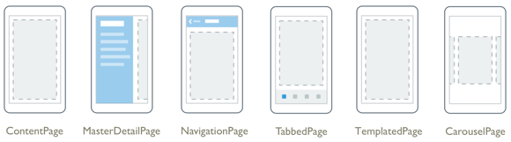
Pages
Notes:
Image courtesy of Xamarin

Slide 30
Layout
Describes the way controls will be oriented on the Page
Many subtypes, including:
Subtypes | Description
ScrollView | Sets up scrolling, if content extends beyond page limits
StackLayout | Orients controls in a horizontal or vertical stack
AbsoluteLayout | Places controls at exactly specified locations on Page
RelativeLayout | Places controls in relation to adjacent views
Grid | Places controls in defined columns and rows
Notes:
References:
Further reading on Layouts: https://developer.xamarin.com/guides/xamarin-forms/controls/layouts/

Slide 31
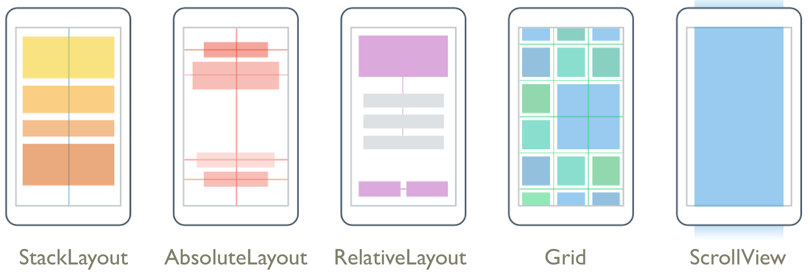
Layouts
Notes:
Image courtesy of Xamarin

Slide 32
StackLayout
StackLayout stackLayout = new StackLayout {
Spacing = 0,
Children = {
new Label {
Text = "Start is flush left",
HorizontalOptions = LayoutOptions.Start,
},
new Label {
Text = "Center",
HorizontalOptions = LayoutOptions.Center
},
new Label {
Text = "End is flush right",
HorizontalOptions = LayoutOptions.End
}
}
this.Content = stackLayout;
Notes:
Notes:
StackLayout is the simplest layout. Left-to-right (horizontal) or top-to-bottom (vertical or stacked).
Three Label views are placed on this StackLayout.

Slide 33
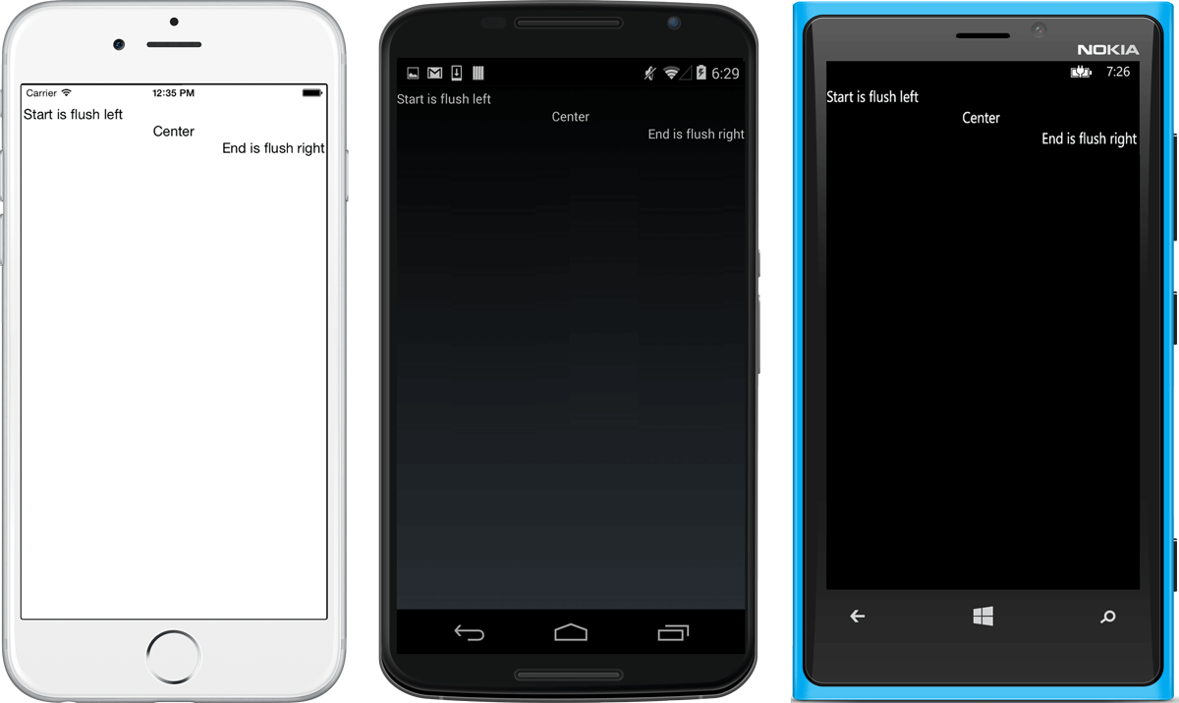
StackLayout
Notes:
References:
Images From Xamarin Mobile Application Development by Dan Hermes http://www.mobilecsharpcafe.com/xamarin-book/

Slide 34
View
Main base class for most UI elements
Contains many basic properties to be inherited by UI elements
Button
Label
Image
Notes:
Notes:
View is the main base class for UI elements
Button
Label
Image
etc.
Basic properties inherited by UI elements:
Margin
HorizontalOptions
VerticalOptions
Etc.
References:
Margin reference: https://developer.xamarin.com/api/property/Xamarin.Forms.View.Margin/
HorizontalOptions reference: https://developer.xamarin.com/api/property/Xamarin.Forms.View.HorizontalOptions/
VerticalOptions reference: https://developer.xamarin.com/api/property/Xamarin.Forms.View.VerticalOptions/
More reading on Views: https://developer.xamarin.com/guides/xamarin-forms/controls/views/

Slide 35
Button
Button button = new Button
{
Text = “Push Me",
FontSize = Device.GetNamedSize(NamedSize.Large, typeof(Button)),
HorizontalOptions = LayoutOptions.Center,
VerticalOptions = LayoutOptions.Fill
};
StackLayout stackLayout = new StackLayout
{
Children =
{
button
},
HeightRequest = 500
};
Notes:
Notes:
Create a Button view and place it on a layout.

Slide 36
Event Handler: Inline or Method
button.Clicked += (sender, args) =>
{
button.Text = " Pushed!";
};
OR
button.Clicked += OnButtonClicked;
. . . which is called outside the page constructor:
void OnButtonClicked(object sender, EventArgs e)
{
button.Text = “Pushed!";
};
Notes:
Notes:
Now let’s assign an event handler, either inline, or by assigning a method.

Slide 37
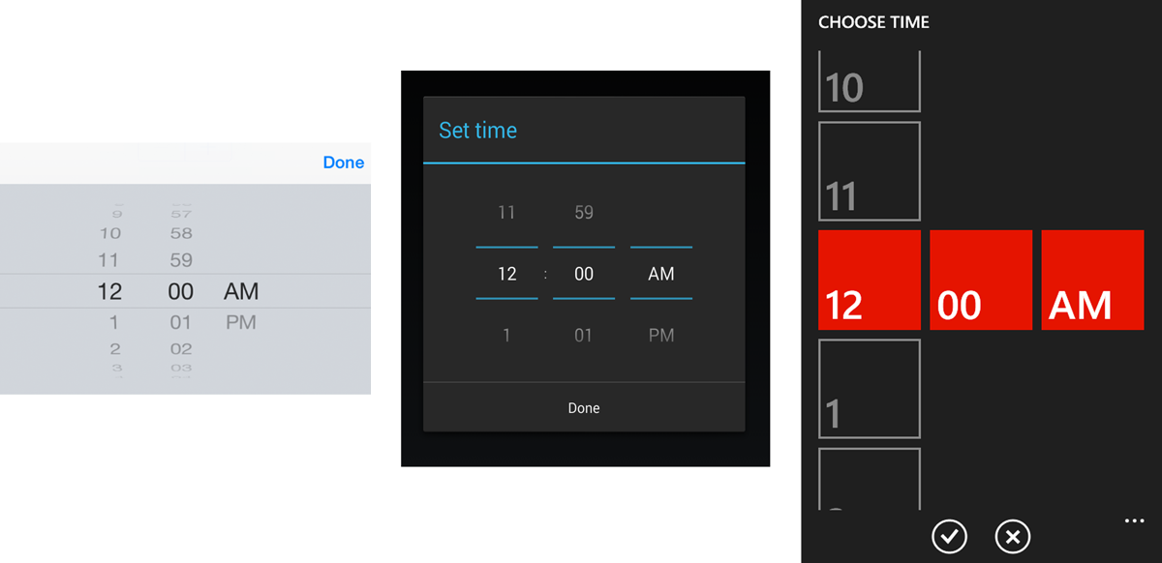
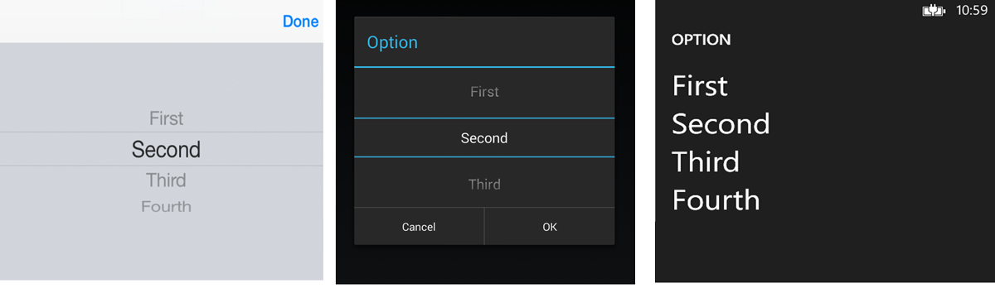
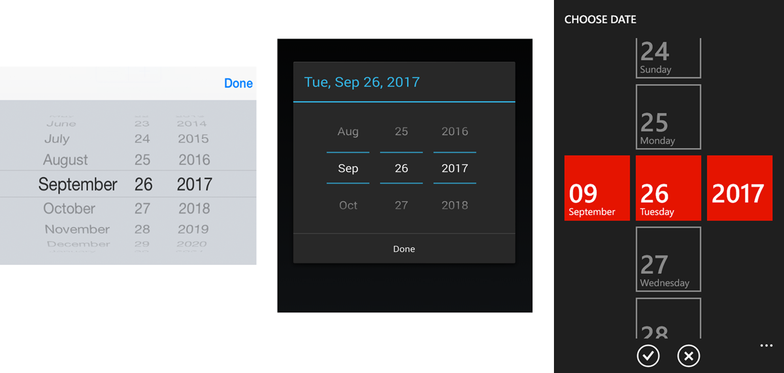
Selection Controls
Picker DatePicker
TimePicker
Notes:
Notes:
Picker– a simple drop-down list
DatePicker – selection of month, date, and year
TimePicker– selection of hour, minute, and AM/PM
References:
Images from Xamarin Mobile Application Development by Dan Hermes http://www.mobilecsharpcafe.com/xamarin-book/

Slide 38

Selection Controls
Stepper
Switch
Slider
Notes:
Notes:
SeekBar – sliding input lever for continuous values
Checkbox – a standard Boolean checkbox control
Switch – boolean on-or-off switch
RadioButton – button groups for single or multiple selection
References:
Images from Xamarin Mobile Application Development by Dan Hermes http://www.mobilecsharpcafe.com/xamarin-book/

Slide 39
Picker
Picker picker = new Picker
{
Title = "Option",
VerticalOptions = LayoutOptions.CenterAndExpand
};
var options = new List<string> { "First", "Second", "Third", "Fourth" };
foreach (string optionName in options)
{
picker.Items.Add(optionName);
}
Notes:
Notes:
First, create the picker and give it a title.
Next, populate the list.

Slide 40
Handle Selection Event
picker.SelectedIndexChanged += (sender, args) =>
{
pageValue.Text = picker.Items[picker.SelectedIndex];
};
Notes:
Notes:
Handle Picker selection event: SelectedIndexChanged
This implementation assigns the selected string to the Text property of the pageValue label.
The selected index in the Picker.SelectedIndex property is a zero-based integer index. If Cancel is
selected, the SelectedIndex remains unchanged.

Slide 41
Summary
In this lesson, you have learned:
When to consider using Xamarin.Forms
The benefits and limitations of Xamarin.Forms
Development fundamentals of Xamarin.Forms
Page, Layout, and View
Basic Views and Selection Controls

